Slide 1
The Incubator Project
What you will need to understand for Firmware development

Slide 2
What the Incubator does
The incubator will maintain an environment for growing microbes within a flask.
It will house the shaker table which will have flasks containing liquid medium with an active culture.
The current user interface uses a web browser, which will communicate with the microcontroller over WiFi.
The web browser will maintain environmental variables for the current (internal) incubator temperature, along with target temperature, and temperature range.

Slide 3
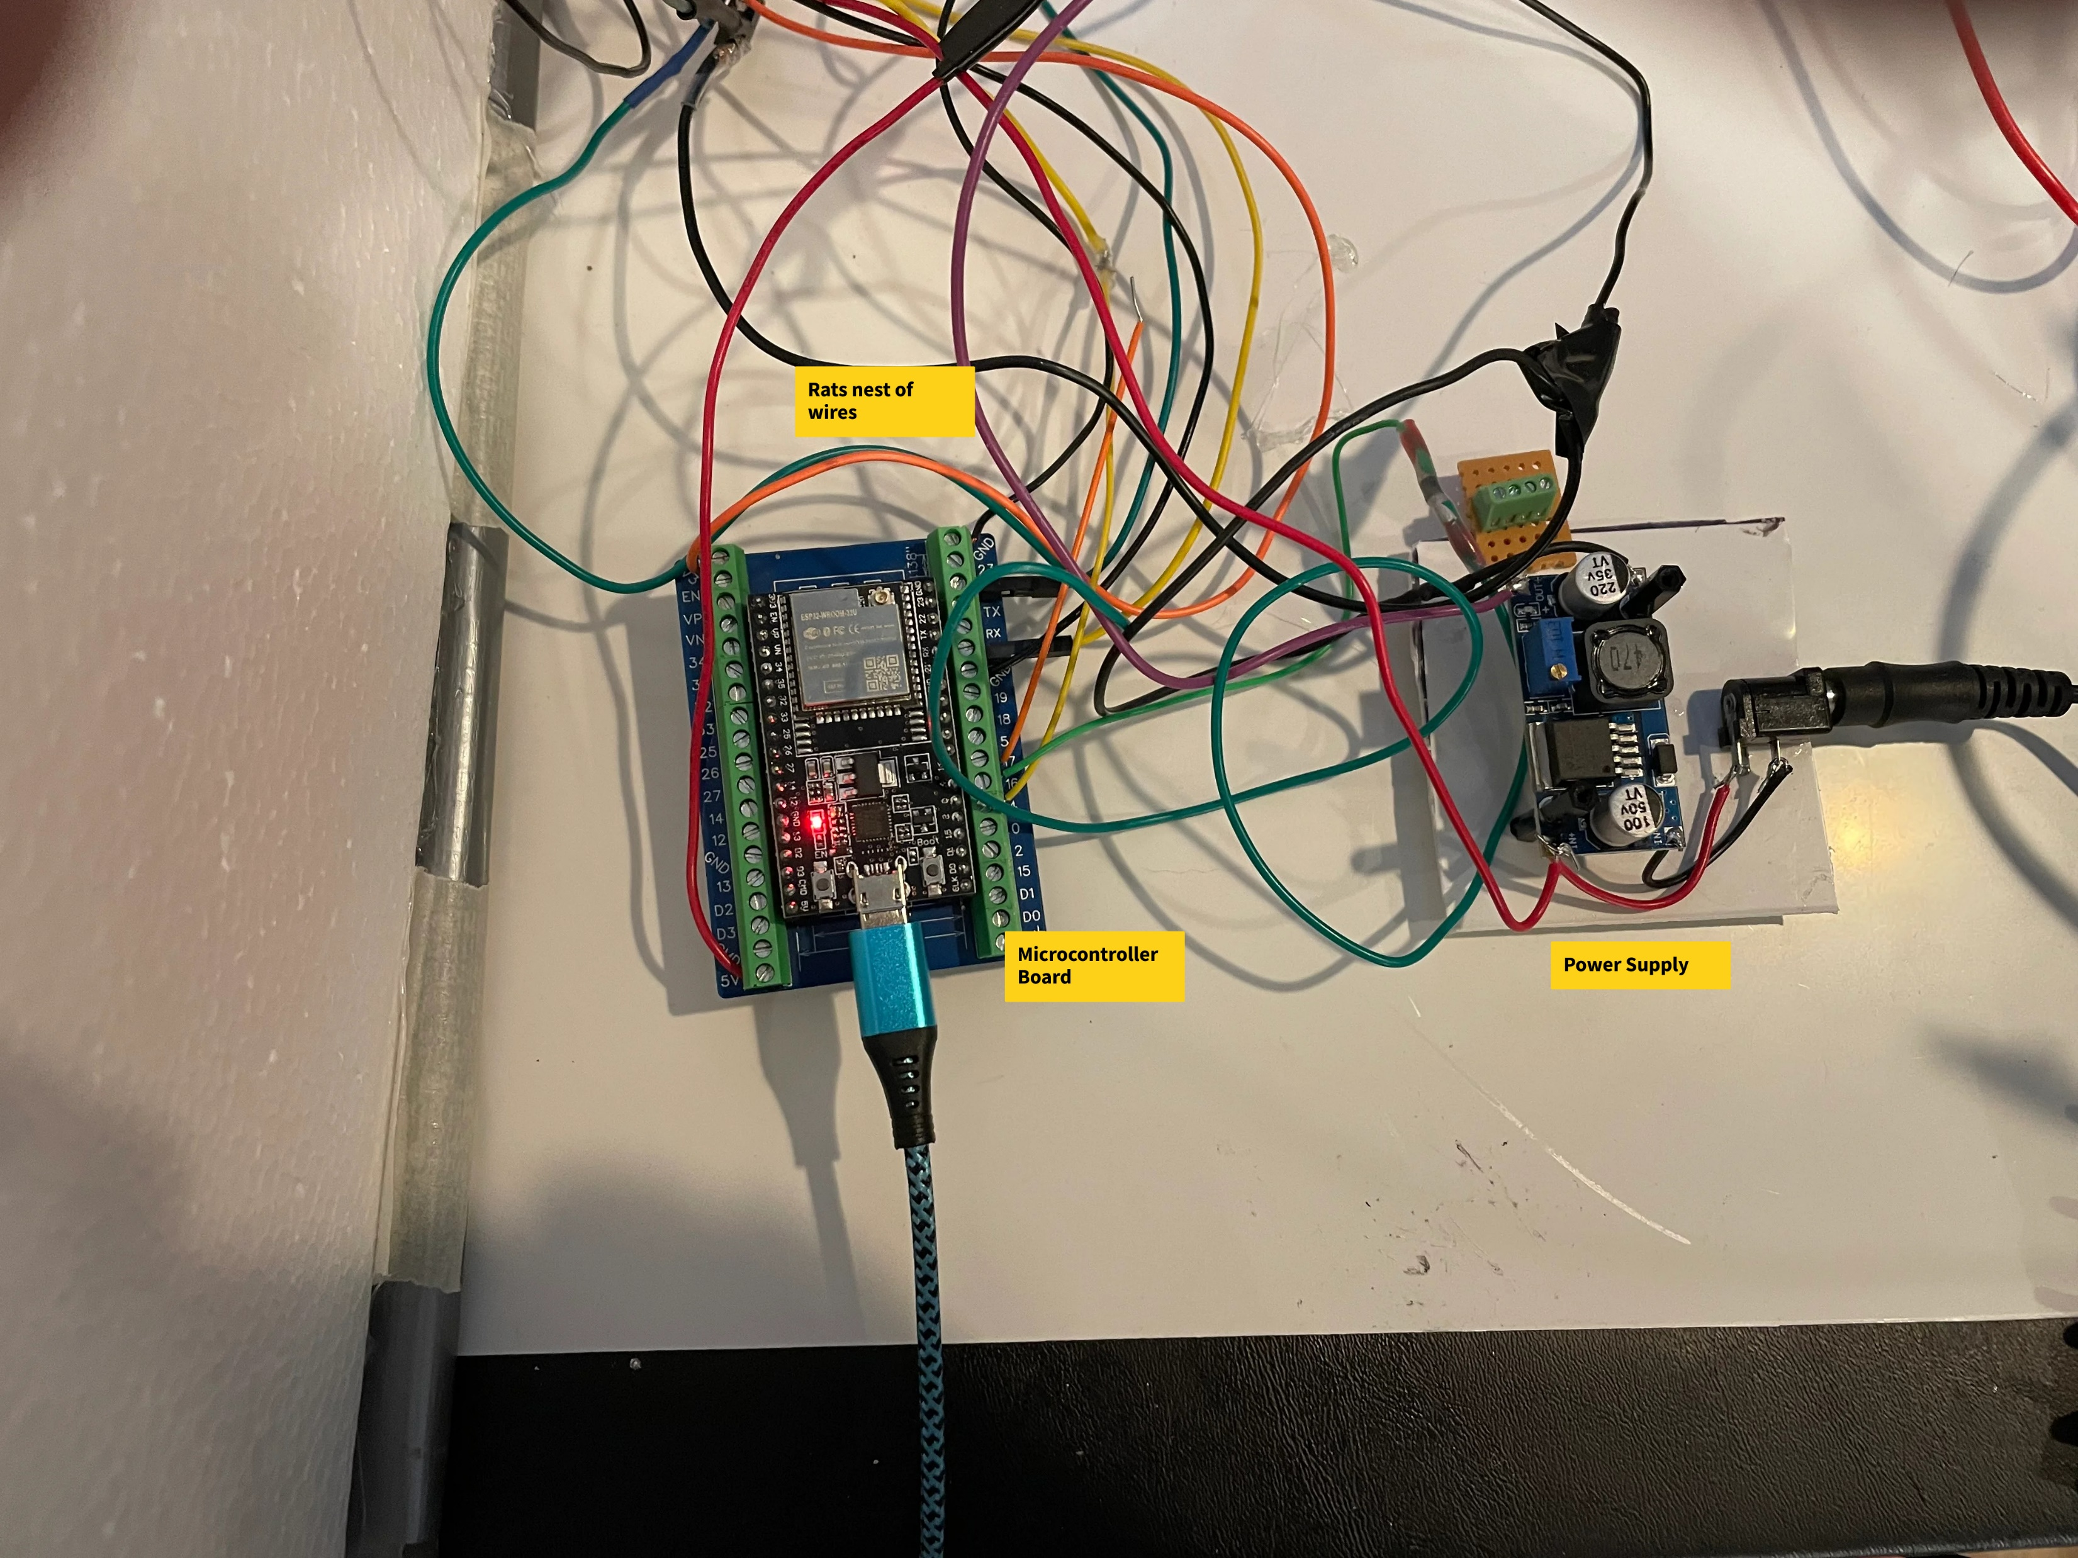
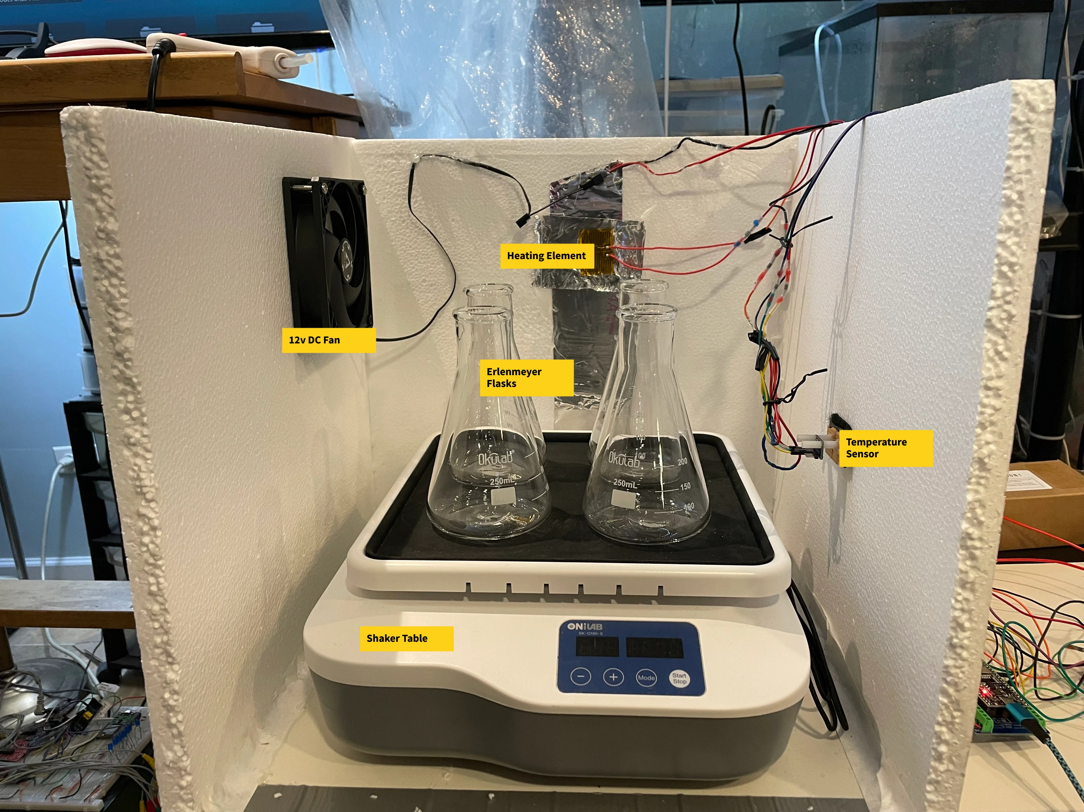
Incubator Proof-of-concept

Slide 4
The Whys of the Incubator Project
Why Grow Microbes?
Why Mycelium?
Why Does Growing Meat and Fish Sound Bizarre?
Why Does Growing Bricks Sound Bizarre?
Why Grow Pharmaceuticals?

Slide 5
Incubator Project: Software basics
Majority of the software is written in C.
We use Microsoft Visual Studio Code IDE for developing the software.
Espressif’s ESP-IDF Framework is used as the key backbone for the system.
The VSCode Espressif ESP-IDF extension is required.
We use Git as the version control system.

Slide 6
Incubator: Espressif ESP-IDF Essentials
ESP-IDF (Espressif IoT Development Framework) is the official, comprehensive software development framework for Espressif Systems' microcontrollers (such as the ESP32 series). (based on Google’s AI engine).
The framework is built to be self-sufficient and includes the following core elements:
Real-Time Operating System (FreeRTOS)
Hardware Abstraction & Drivers
Networking & Communication Stacks
Security & Storage
Build & Debug Tools

Slide 7
Incubator, ESP32 Architecture Specifics
32-bit architecture.
GPIO. General Purpose IO.
I2C communications. Most of the sensors that we use are I2C devices. I2C is a serial bus type architecture.
SPI communications. Used with some LCD boards. Also a serial bus type architecture
WiFi communications.
Non-volatile storage.

Slide 8
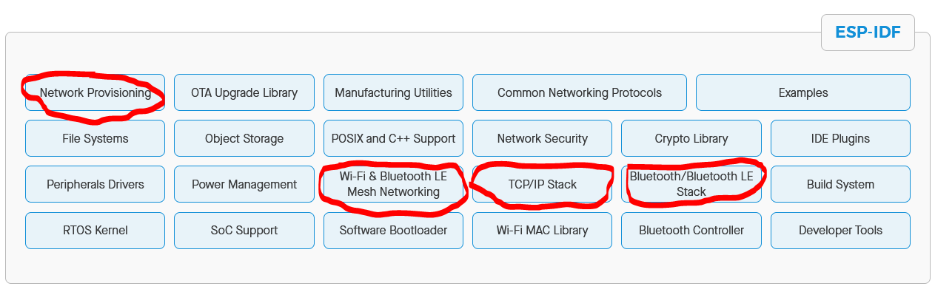
Incubator: ESP-IDF Components

Slide 9
Incubator: Building the application
The project is in the ESPIDF_Incubator Github Repository. Directions for cloning and building forthcoming.

